Slide 1
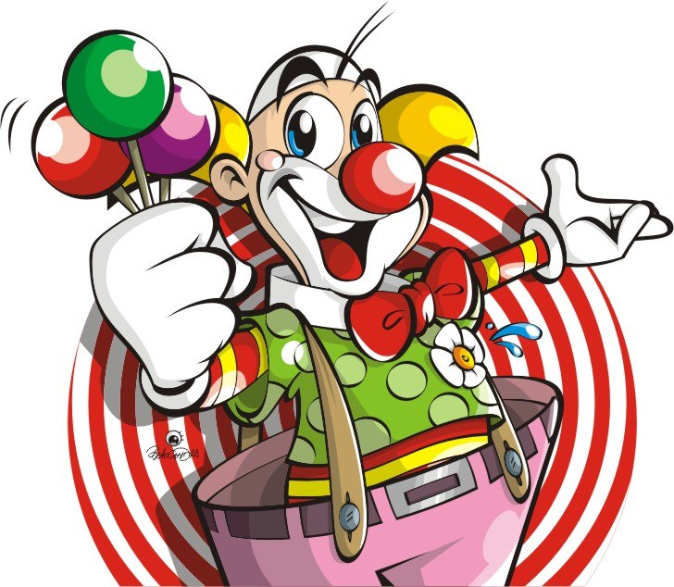
THE FUN STARTS HERE!

Slide 2
How are you today?
bored
lazy
hungry
fine
thirsty
full
sad

Slide 3
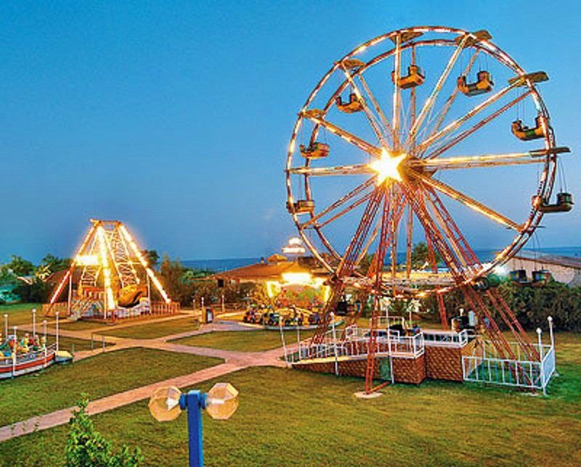

Slide 4
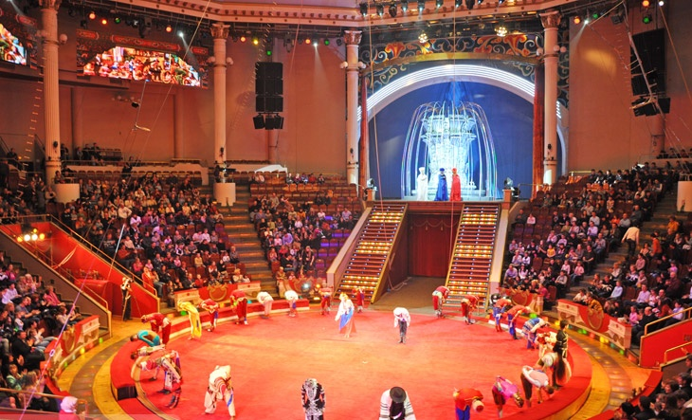

Slide 5
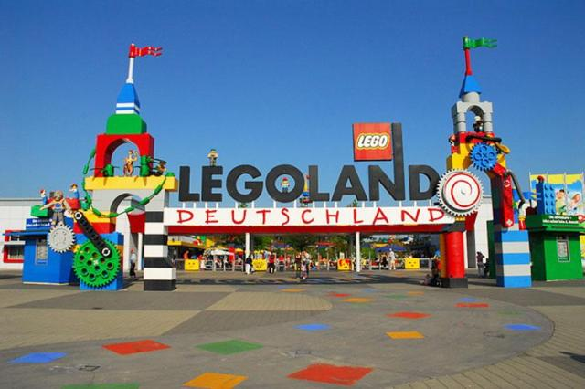

Slide 6
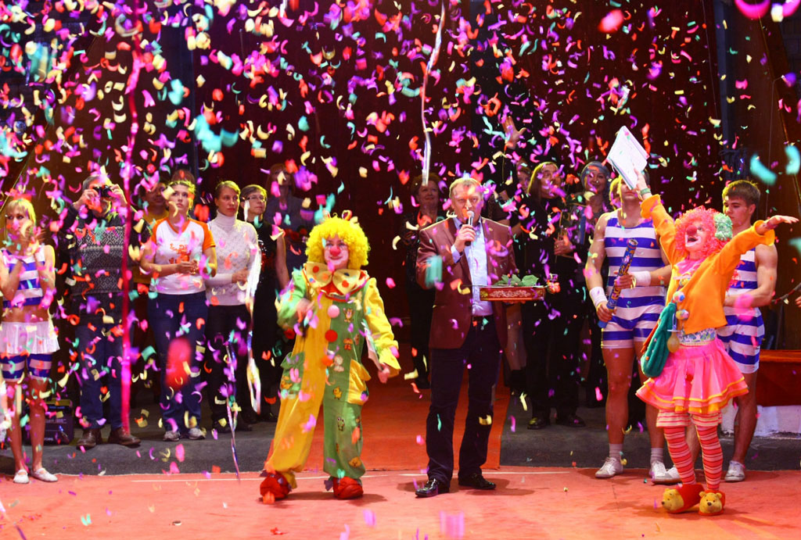
FUN FAIR
CIRCUS
THEME PARK

Slide 7
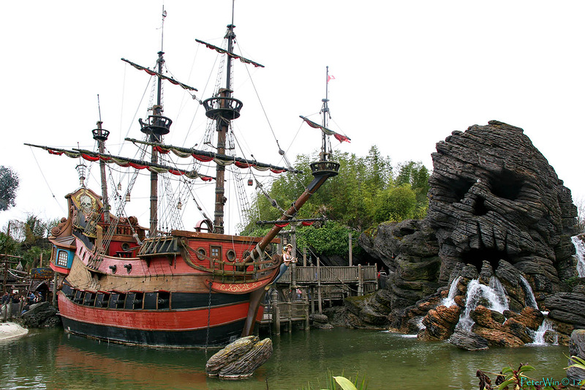
Fly in a pirate ship

Slide 8
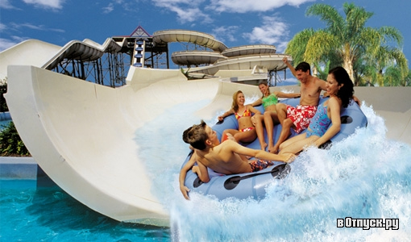
Go on a water ride

Slide 9
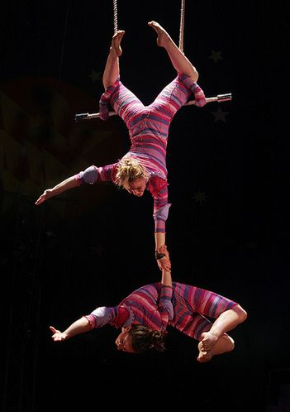
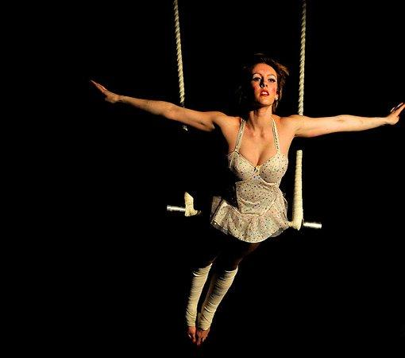
See trapeze artists

Slide 10
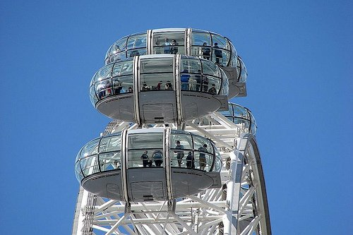
Ride on a big wheel ..

Slide 11
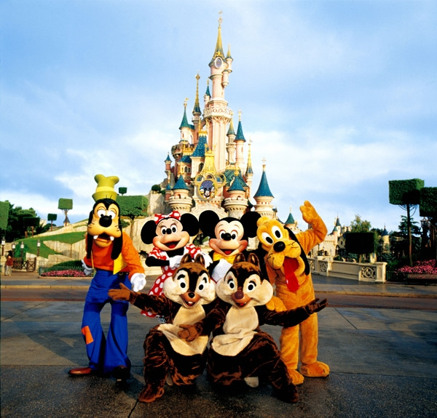
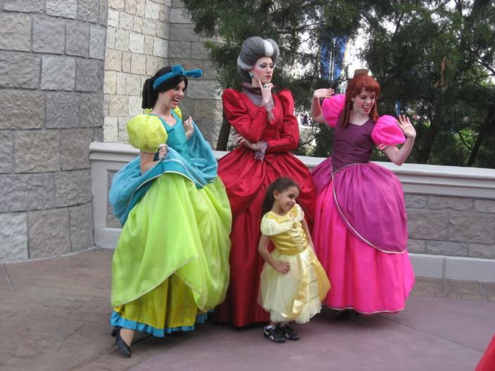
Shake hands with cartoon character

Slide 12
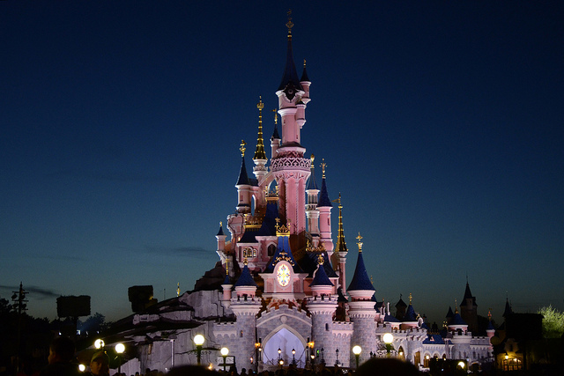
Explore a haunted mansion

Slide 13
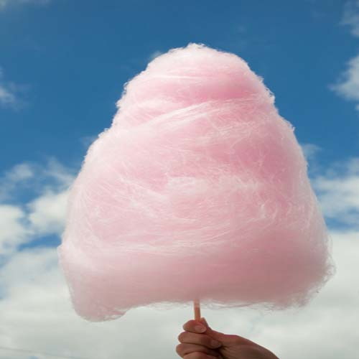
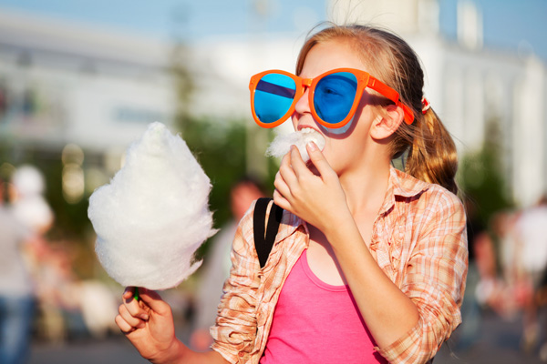
Eat candy floss

Slide 14
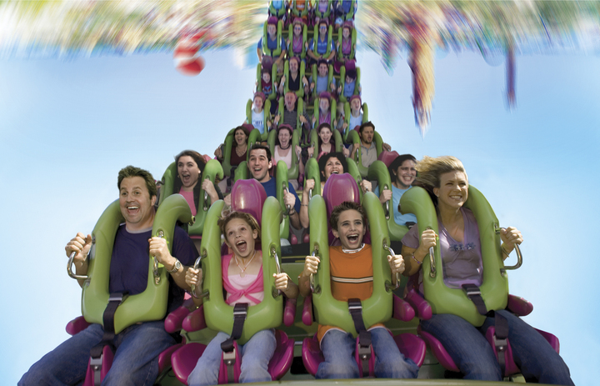
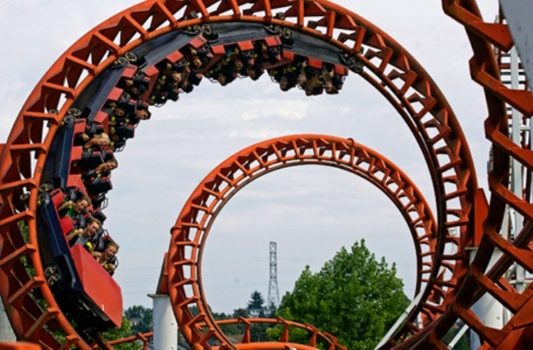
Ride on a rollercoaster

Slide 15
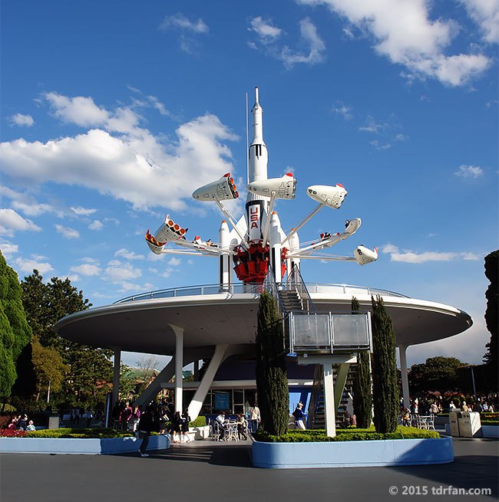
Go on a rocket
journey

Slide 16
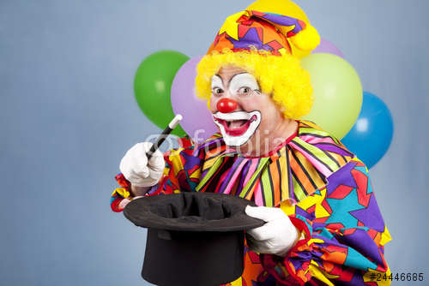
See clown performing tricks

Slide 17
Match the activities to the place
ride on the big wheel
fly in a pirate ship
explore a haunted mansion
meet a ghost
shake hands with cartoon characters
eat candy floss
go souvenir shopping
see trapeze artists
go on a water ride
see clowns performing tricks
ride on a rollercoaster

Slide 18
Present perfect
have/ has + V3/ed
fly
flown
go
gone
ride
ridden
see
seen
eat
eaten
shake
shaken
explore
explored
Have you ever …… ? –Yes, I have. /No, I haven’t.

Slide 19
Match the words to form collocations.
Then use then to Complete the sentences.
haunted a. shopping
souvenir b. ship
candy c. mansion
pirate d. park
Theme e. rides
hair-raising f. floss

Slide 20
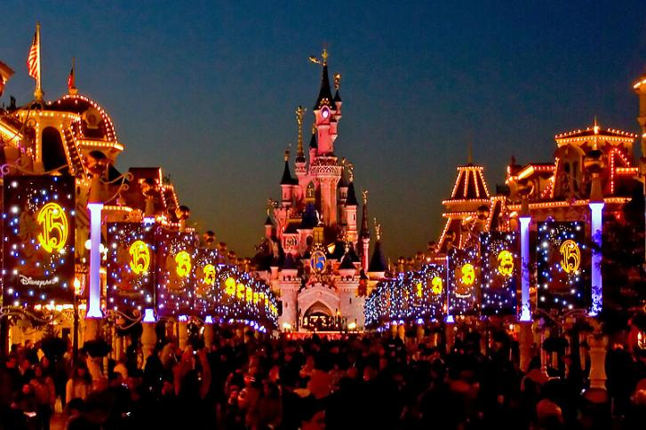
Whenever we go to a funfair, we buy _____
because we love sweets.
2. Mary didn’t explore the __________ with us.
She was too afraid.
3. We took a ride on the ___________ in the theme. It was great!
4. We bought a Mickey Mouse doll while ______
in Disneyland.
5. Disneyland is a world famous _____________
in the United States.
6. We have been on some _____________ at Alton

Slide 21
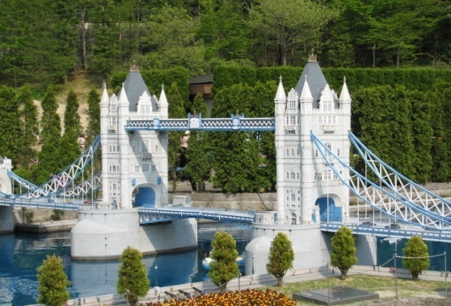
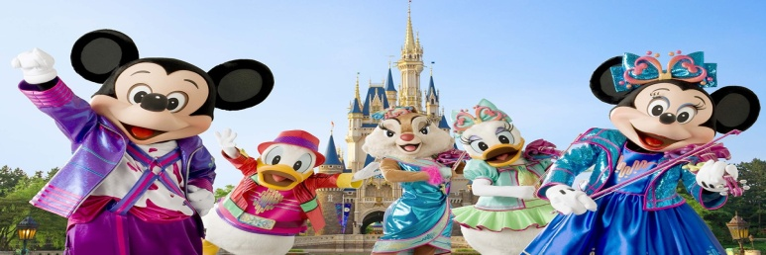
Listen and complete the texts
With the correct information
A world
Of
Wonders
Forget all about your real self and enter the world of fantasy at …
Go on the Jungle Cruise, explore tiny worlds, go on a 1) ____ ____ at Splash Mountain and eat a 2) _______ meal at Grandma Sara’s Kitchen.
Before you return to the real world, make sure:
you have shaken 3)________ with your favourite cartoon 4)________ ,
you have explored the Haunted ____
and you’ve come across some 4)______,
you have flown with Peter Pan in a 5)____
ship through the night skies,
you have ridden the Toontown 6) ______,
you have gone on a 7)________ journey in a
StarJet.
Have you ever wished you could travel around the world in minutes?
Have you ever dreamt of seeing the word’s most famous landmarks all in one place?
Then visit Tobu World Square in Japan, the most unusual 1)_______ park you've ever seen. See more than 100 tiny models of the world's most 2)_____ buildings, bridges and 3)__________. Take a stroll around the Taj Mahal, the Colosseum, the Great Wall of China and London Bridge. When you get tired of sightseeing, enjoy a 4)_______ in a restaurant or go 5) _________ shopping at World Shoppers "Mercado II". Book now! You've never seen anything like it!
Disneyland
Tokyo

Slide 22
Read the texts. Where can you…:
1) see famous landmarks?
2) have lunch?
3) have a scary experience?
4 )see small buildings?
5) see funny characters?

Slide 23
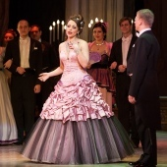
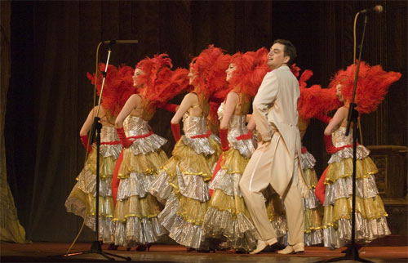
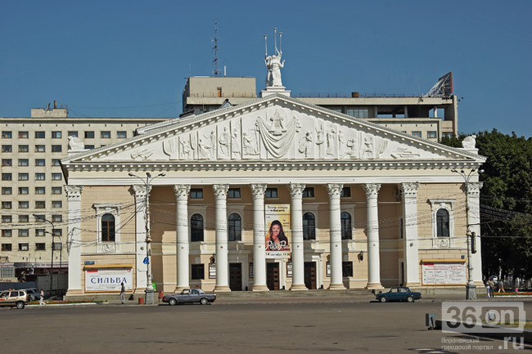
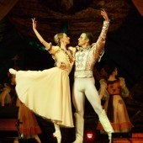
Voronezh State Opera and Ballet Theatre

Slide 24
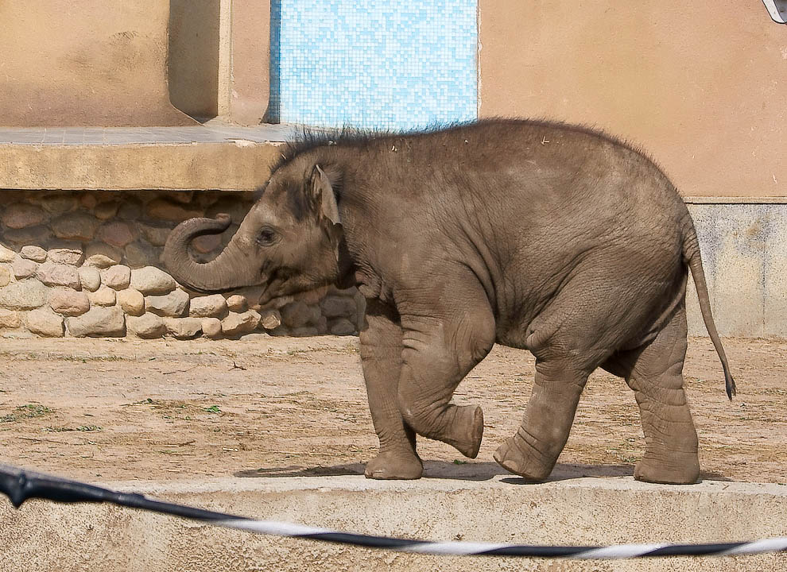
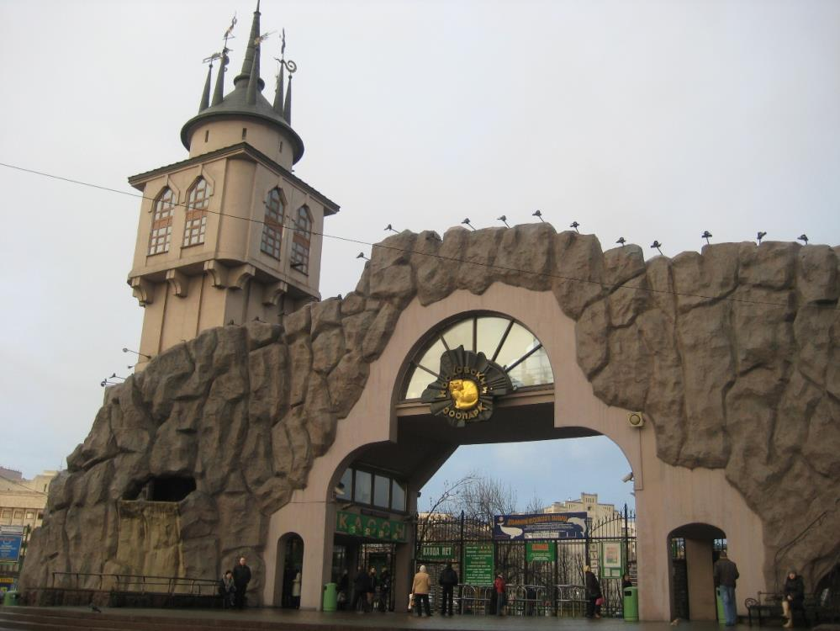
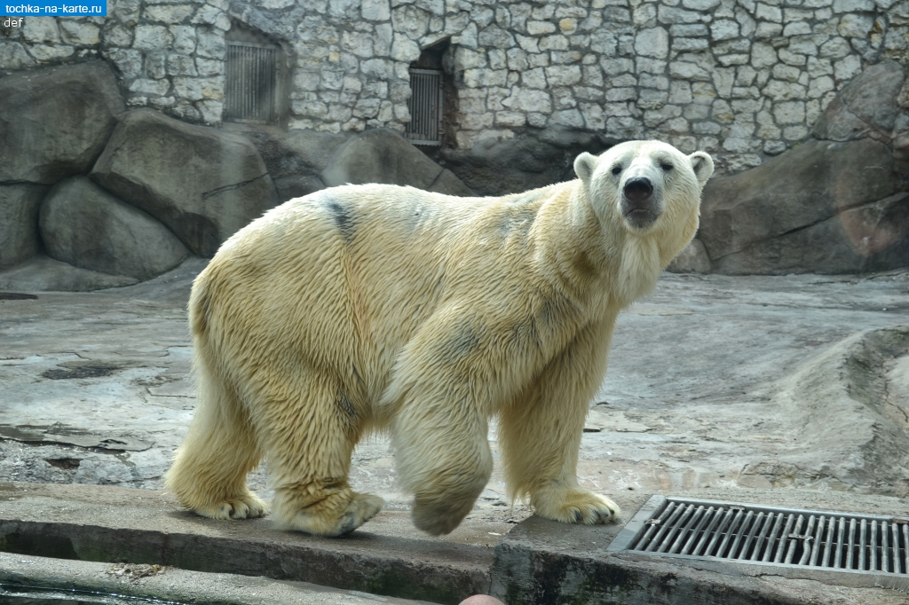
Moscow Zoo

Slide 25
Put the verbs in the correct form of the present perfect.
1. A: _____________(you/ever/eat) candy floss at a theme park?
B: No, haven’t. But I _____________ (hear) that it’s very tasty?
2. A: I ______________ (never/ travel) outside Europe. Have you?
B: Yes, I visited Tokyo six month ago.
3. A: ____________________ (you/ever/explore) the Haunted Mansion at Disneyland?
B: Yes, I have. But I ________________ (not/see) Peter Pan on the pirate ship.
4. A : We ________________ (visit ) two theme parks so far.
B: So have we. But we ______________(not/be) on any rollercoaster rides.

Slide 26
The lesson is over! Goodbye!

